Slide 1



themba blocking
View in Power BI
Last data refresh:
9/30/2023 11:39:36 PM UTC
Downloaded at:
10/29/2023 12:19:49 AM UTC

Slide 2
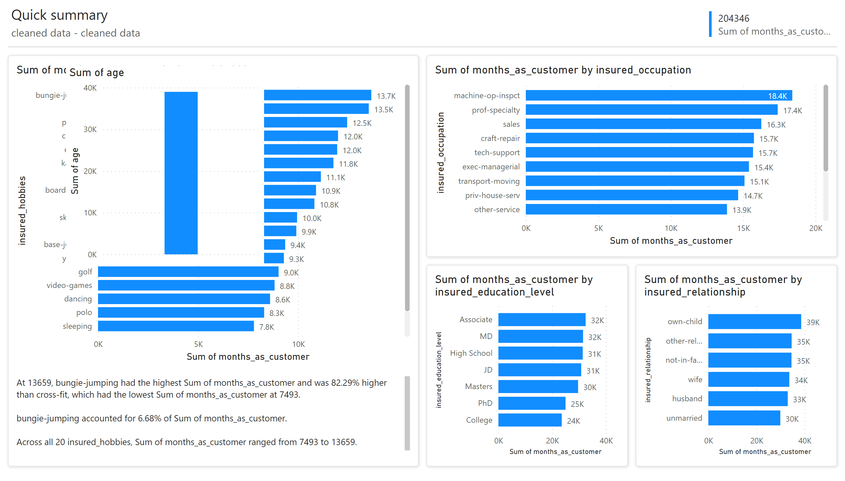
Page 1
Notes:
clusteredBarChart
No alt text provided
clusteredBarChart
No alt text provided
clusteredBarChart
No alt text provided
clusteredBarChart
No alt text provided
shape
No alt text provided
textbox
No alt text provided
shape
No alt text provided
shape
No alt text provided
shape
No alt text provided
textbox
No alt text provided
textbox
No alt text provided
multiRowCard
No alt text provided
shape
No alt text provided
clusteredColumnChart
No alt text provided

Slide 3
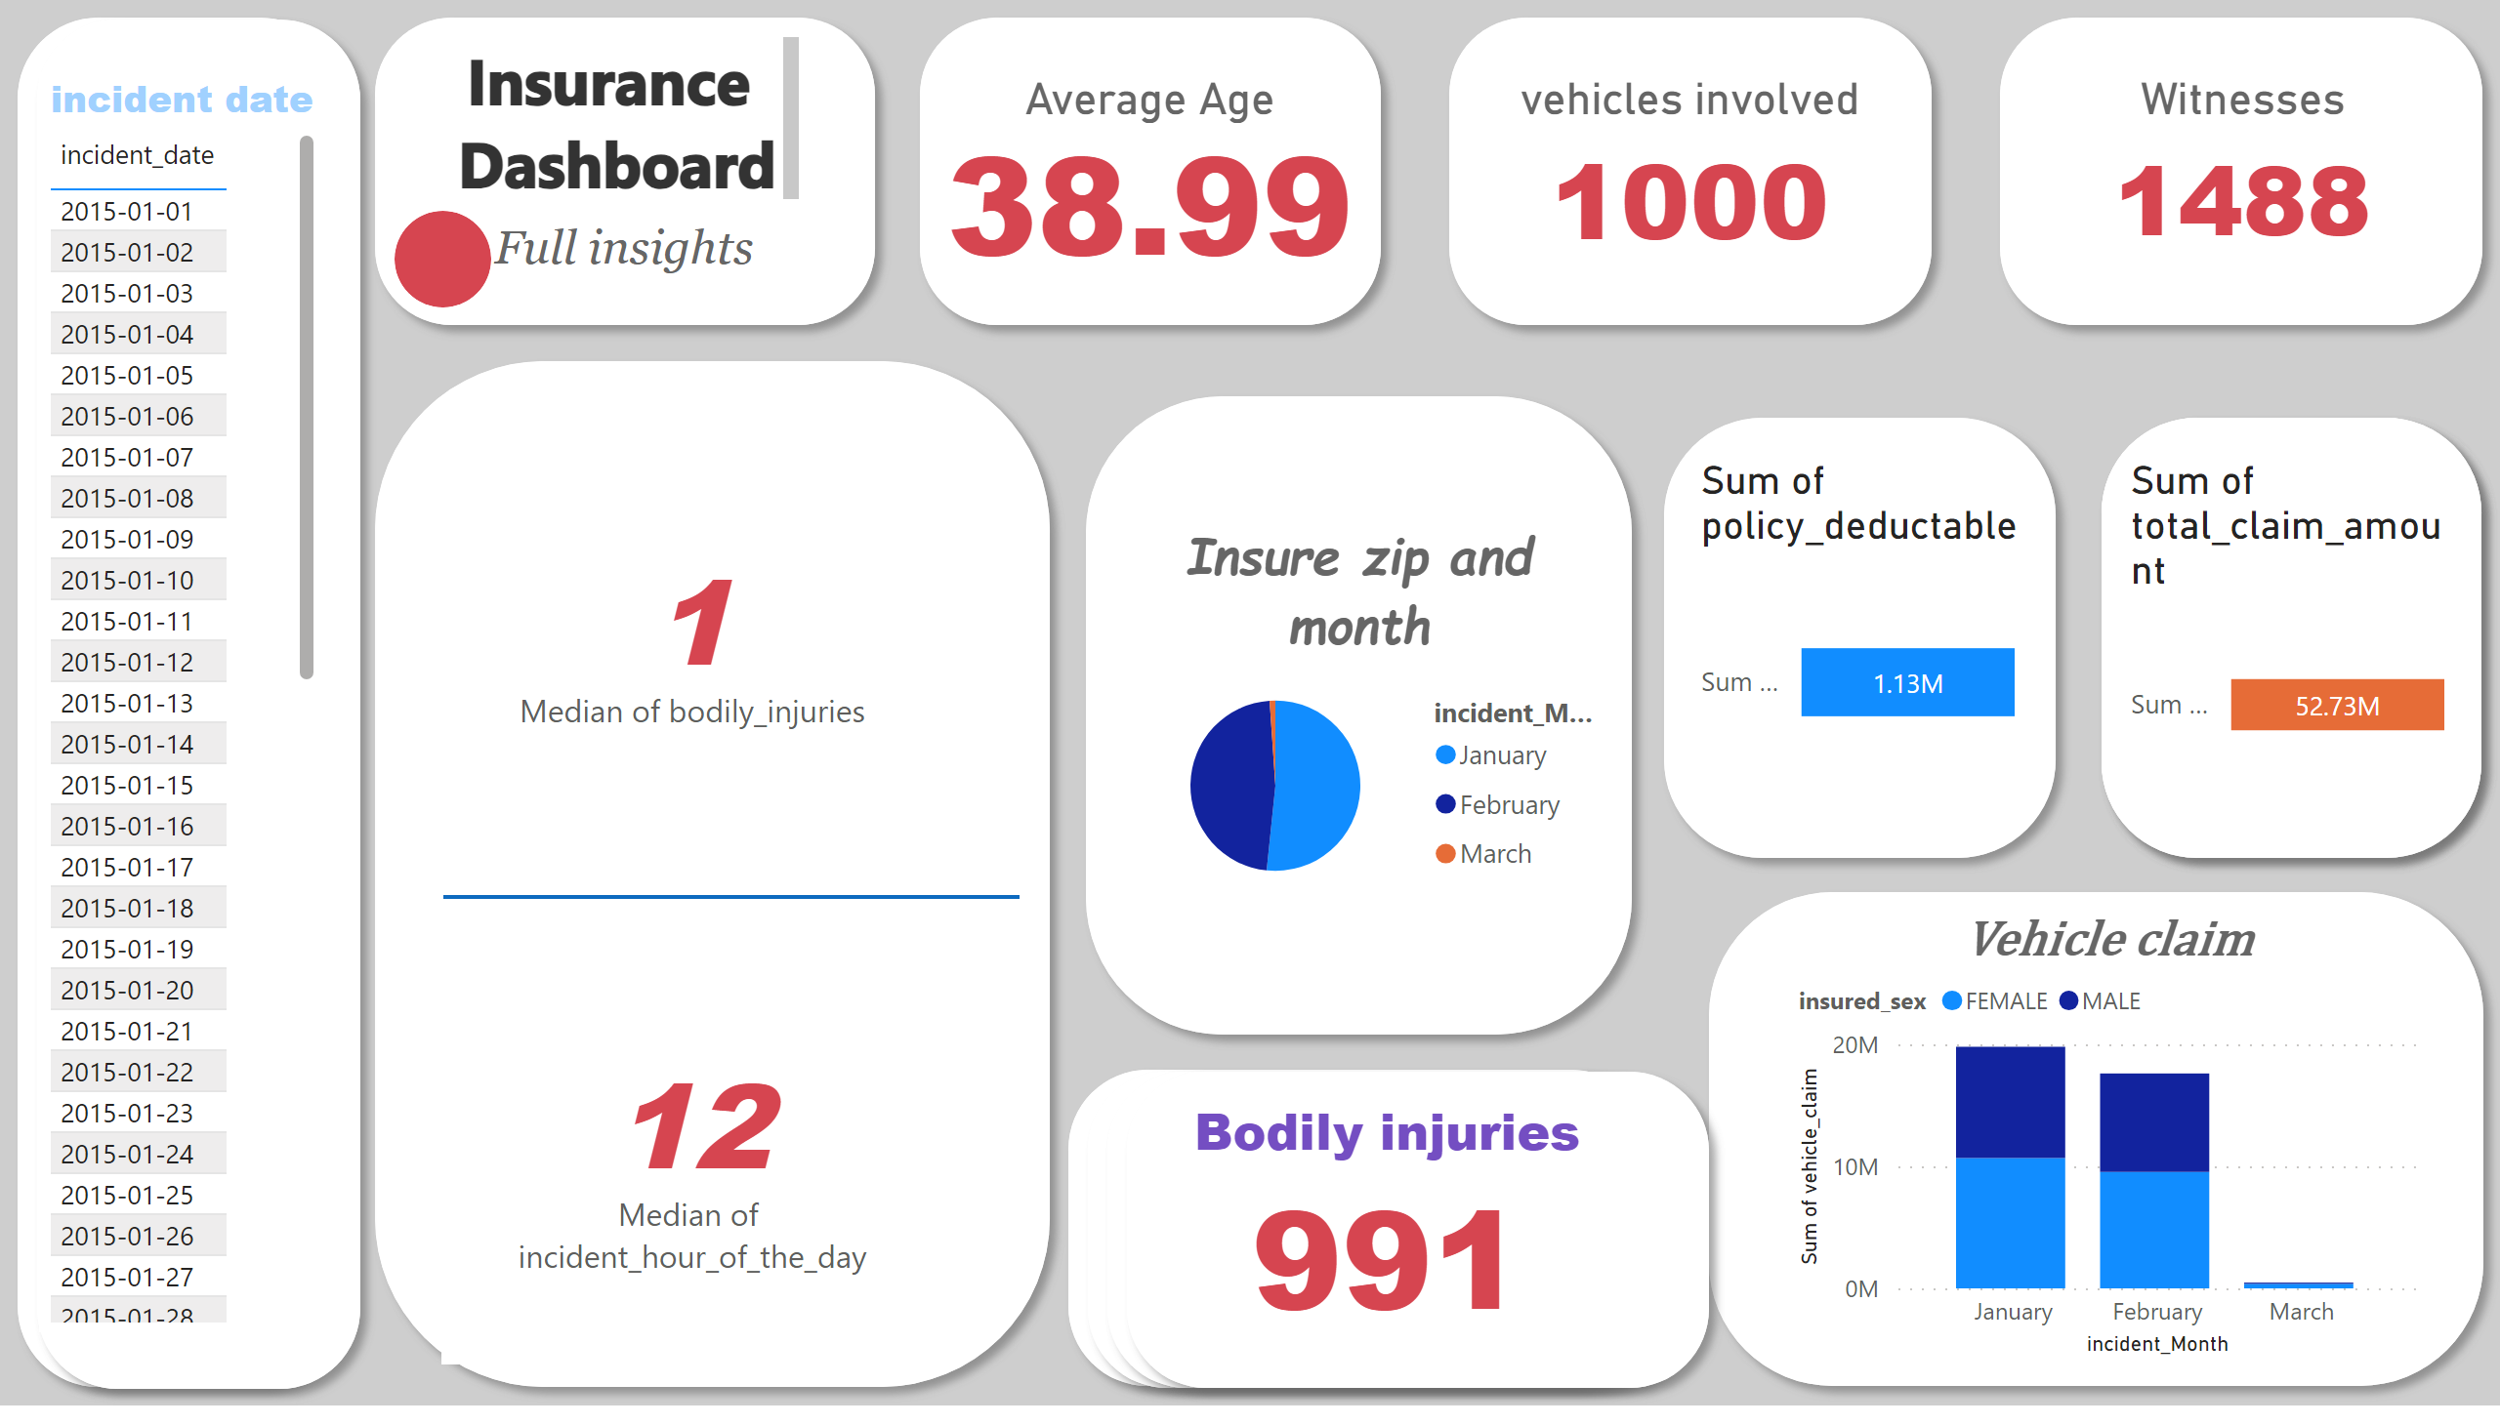
Page 2
Notes:
Witnesses
No alt text provided
vehicles involved
No alt text provided
Average Age
No alt text provided
shape
No alt text provided
textbox
No alt text provided
shape
No alt text provided
textbox
No alt text provided
Vehicle claim
No alt text provided
Insure zip and month
No alt text provided
textbox
No alt text provided
shape
No alt text provided
card
No alt text provided
card
No alt text provided
incident date
No alt text provided
Bodily injuries
No alt text provided
shape
No alt text provided
shape
No alt text provided
shape
No alt text provided
funnel
No alt text provided
shape
No alt text provided
funnel
No alt text provided
shape
No alt text provided
shape
No alt text provided
shape
No alt text provided
shape
No alt text provided
shape
No alt text provided
shape
No alt text provided
shape
No alt text provided
shape
No alt text provided
shape
No alt text provided
shape
No alt text provided
shape
No alt text provided

